Slide 1


Week 4
Pub/Sub
Part 1
DCS, SMCS
Internet of Things
IoT
Faisal Iradat

Slide 2
What is a message broker?
A message broker is software that enables applications, systems and services to communicate with each other and exchange information
Message brokers:
Software modules within messaging middleware or message-oriented middleware (MOM) solutions
Middleware provides developers with a standardized means of handling the flow of data between an application’s components so that they can focus on its core logic
It can serve as a distributed communications layer that allows applications spanning multiple platforms to communicate internally

Slide 3
Message Broker
Message brokers can:
validate, store, route, and deliver messages to the appropriate destinations
Serve as intermediaries between other applications, allowing senders to issue messages without knowing where the receivers are, whether or not they are active, or how many of them there are
This facilitates decoupling of processes and services within systems
Message brokers often rely:
Substructure or component called a message queue
Stores and orders the messages until the consuming applications can process them
In a message queue, messages are stored in the exact order in which they were transmitted and remain in the queue until receipt is confirmed.
Asynchronous messaging
Queue managers

Slide 4
Broker Models
Point-to-point messaging
A one-to-one relationship between the message’s sender and receiver
Called for when a message must be acted upon only one time
Example: payroll and financial transaction processing
Both senders and receivers need a guarantee that each payment will be sent once and once only
Publish/subscribe messaging
Often referred to as “pub/sub,”
The producer of each message publishes it to a topic, and multiple message consumers subscribe to topics from which they want to receive messages
All messages published to a topic are distributed to all the applications subscribed to it
One-to-many relationship between the message’s publisher and its consumers
Airline were to disseminate updates about the landing times or delay status of its flights, multiple parties could make use of the information
Ground crews performing aircraft maintenance and refueling, baggage handlers, flight attendants and pilots preparing for the plane’s next trip, and the operators of visual displays notifying the public

Slide 5
Message Broker in Cloud
Cloud-native application:
Made up of small, discrete, reusable components called microservices
Deployed and can run independently of the others
Any one of them can be updated, scaled, or restarted without affecting other services in the system
Packaged in containers, microservices work together to comprise a whole application, though each has its own stack, including a database and data model that may be different from the others
Microservices must have a means of communicating with one another in order to operate in concert – Shared Communication Backbone
Message brokers are often used to manage communications between on-premises systems and cloud components in hybrid cloud environments
Message brokers can play a similar role in integrating multicloud environments, enabling communication between workloads and runtimes residing on different platforms
They’re also well suited for use in serverless computing, in which individual cloud-hosted services run on demand on a per-request basis

Slide 6
Message Broker VS API
Representational State Transfer (REST) APIs are commonly used for communications between microservices
Set of principles and constraints that developers can follow when building web services
Communicate via a set of uniform shared stateless operators and requests
REST APIs use Hypertext Transfer Protocol (HTTP) to communicate

Slide 7
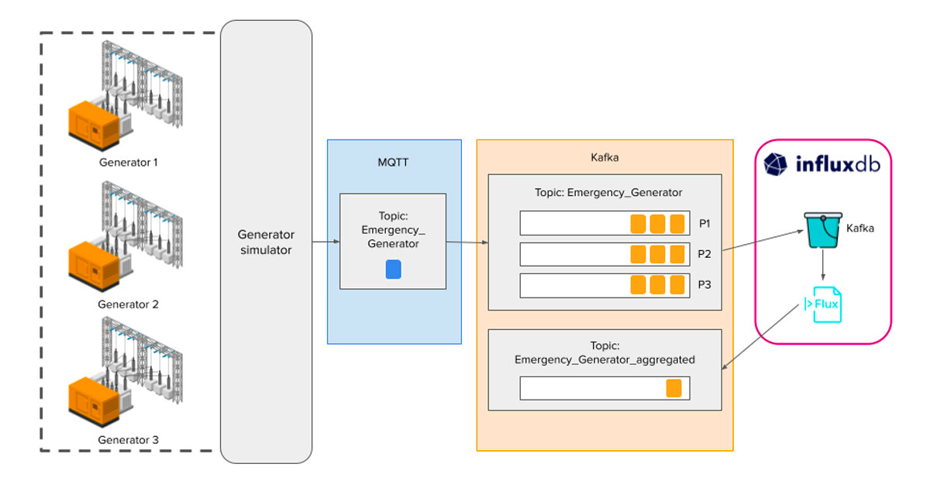
MQTT Broker
Message Queueing Telemetry Transfer, or MQTT
Lightweight IP-based messaging protocol designed for communication between sensors, controllers, and other devices
Designed to support equipment that may not always be online, like automated devices built with microcontrollers
MQTT server programs are called brokers
MQTT VS KAFKA
MQTT: Transmit messages with low latency and does not offer any built-in functions for long-term data storage
Kafka: Provides robust data storage capabilities and can retain messages for extended periods of time (configurable) for reprocessing or referencing in the event of an error

Slide 8
MQTT Broker
Messages are organized into topics
A weather station might have the main topic “station” with subtopics “temperature”, “humidity”, “air quality”, and so forth
The weather station itself would send messages to each of the subtopics, and a web client might subscribe to those topics to graph them onscreen over time
Clients either publish new messages to topics, or subscribe to topics
MQTT is known as a Publish & Subscribe, or PubSub system.
Good about MQTT, as opposed to HTTP
A simple protocol
Send anything you want in a message
Whatever formatting you want
When you subscribe to a topic, you get updates whenever a new message from a remote client arrives
Offers the convenience of web sockets, but without having to maintain a connection to the server, as all communication is message-based, not session-based
Text-formatted messages
Comma-separate values (CSV), JSON strings inside an MQTT message

Slide 9

Desktop and Mobile Client Apps
MQTT Explorer
A desktop client
Client-to-broker communication
MQTTX
A desktop client for Windows, MacOS, Linux, and Ubuntu
MQTTTool
A mobile client for iOS
MyMQTT
Android MQTT client app
MQTT.fx

Slide 10
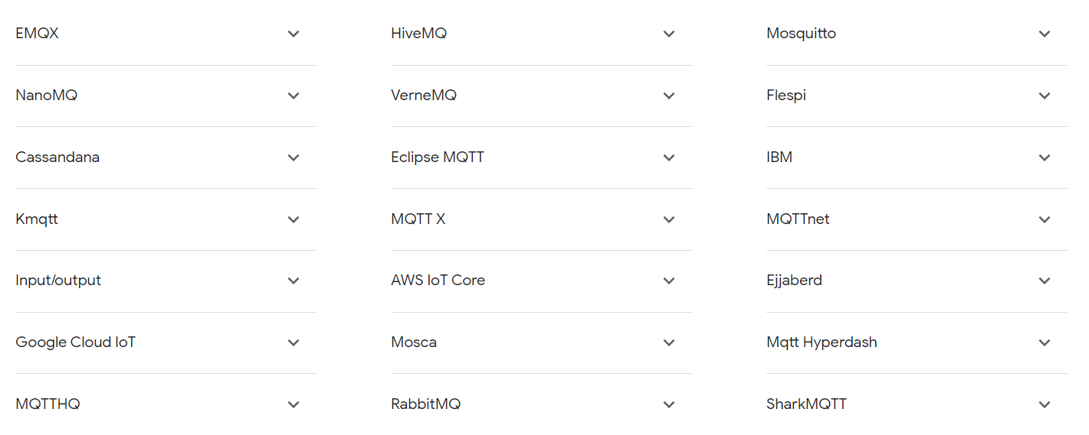
MQTT Brokers

Slide 11
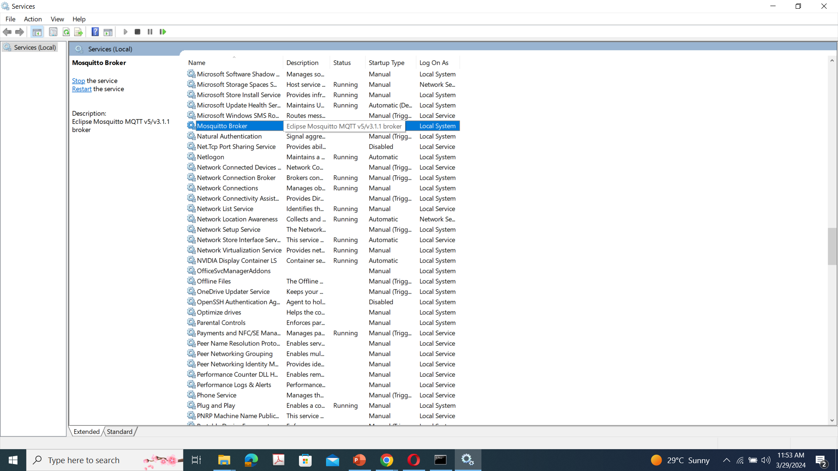
Hands-on
What’s needed
Mosquitto

Slide 12
Hands-on
Starting Mosquitto
Run CMD as administrator
net start mosquito
netstat –a
Open another CMD
cd \Program Files\Mosquitto
mosquitto_sub –t test_sensor_data –h localhost
Open another CMD
cd \Program Files\Mosquitto
mosquitto_pu –t test_sensor_data –h localhost –m “temp 100”
mosquitto_pu –t test_sensor_data –h localhost –m “temp 150”

Slide 13
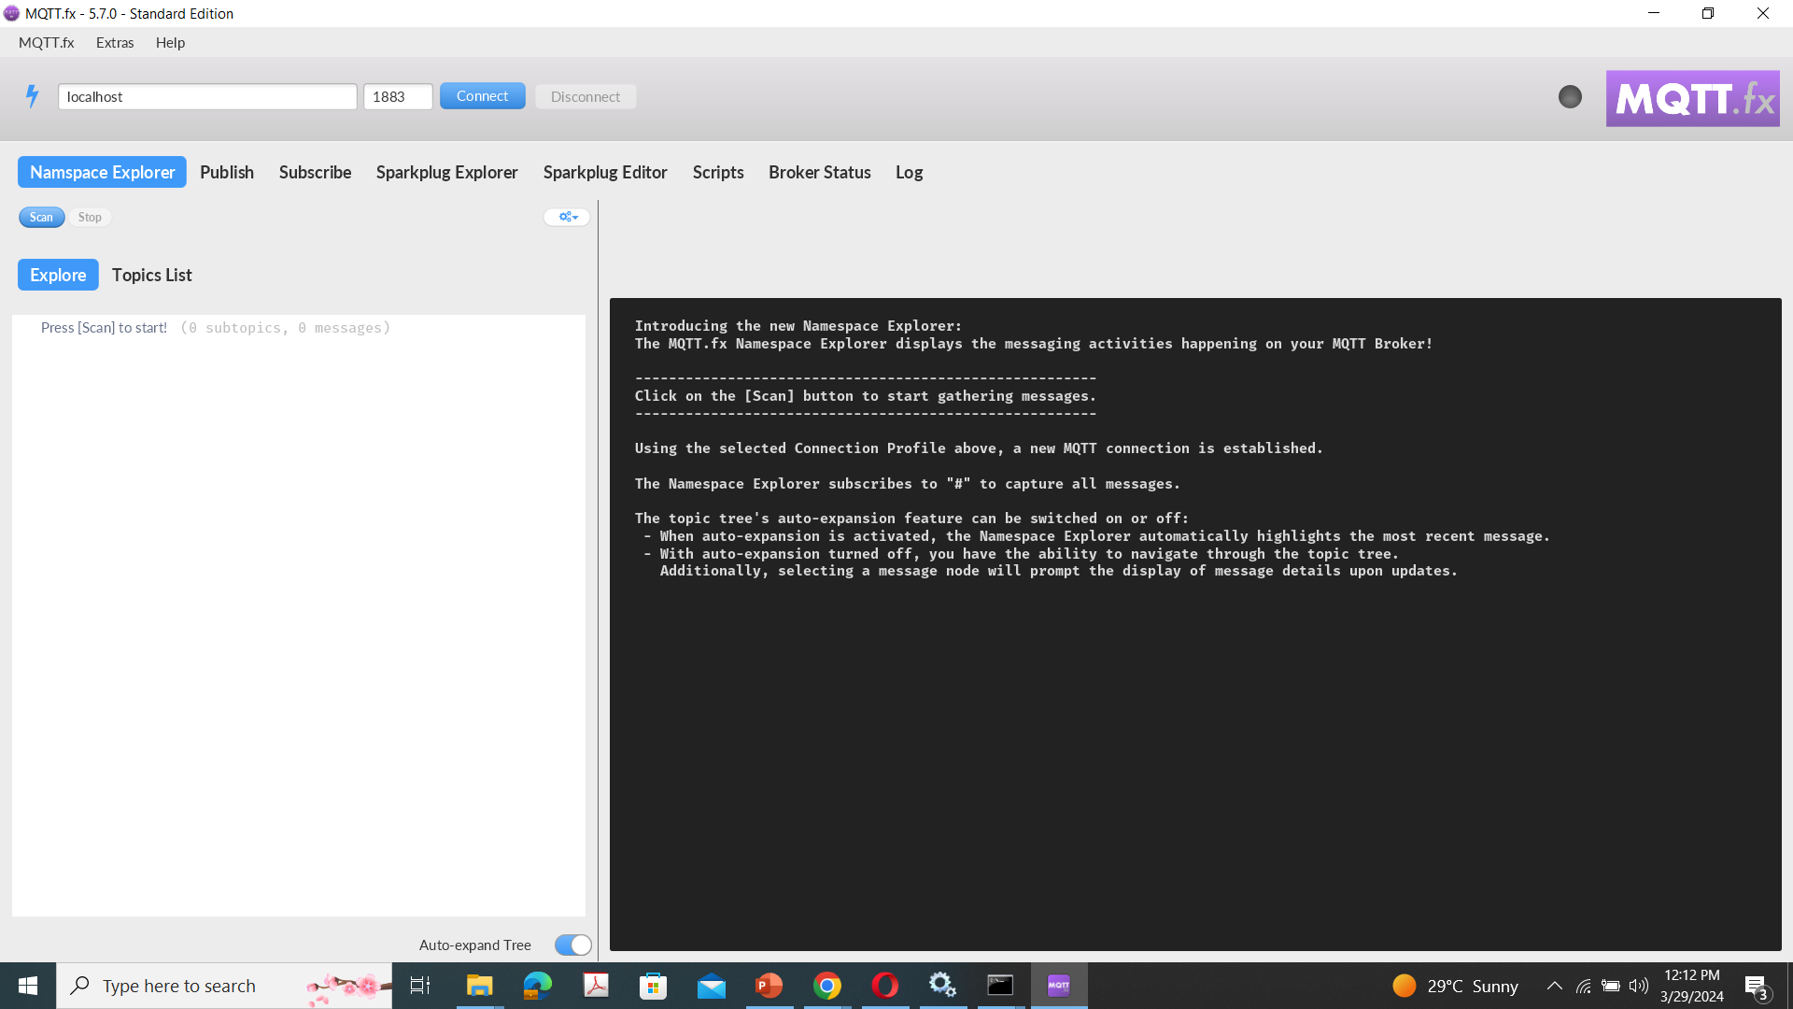
Hands-on
MQTT.fx

Slide 14
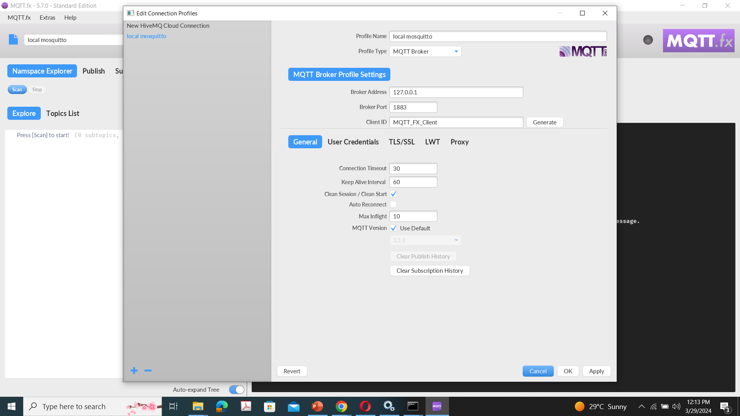
Hands-on
MQTT.fx

Slide 15
Hands-on
Click Publish on MQTT.fx
Topic: Test
In Editor type {“Test0”:0}
Open CMD with mosquitto
mosquitto_sub –h 127.0.0.1 –t Test
mosquitto_sub –h 127.0.0.1 –t Test –d
mosquitto_sub –h 127.0.0.1 –t Test –d –q 1
mosquitto_sub –h 127.0.0.1 –t Test –d –q 2
mosquitto_sub –h 127.0.0.1 –t Test –d –q 2 –k 5

Slide 16
Hands-on
Click Subscribe on MQTT.fx
Topic: Test
Open CMD with mosquitto
mosquitto_pub -h 127.0.0.1 -t Test -m {"Key0":01} -d -q 1
mosquitto_pub -h 127.0.0.1 -t Test1 -m {"Key0":01} -d -q 1

Slide 17
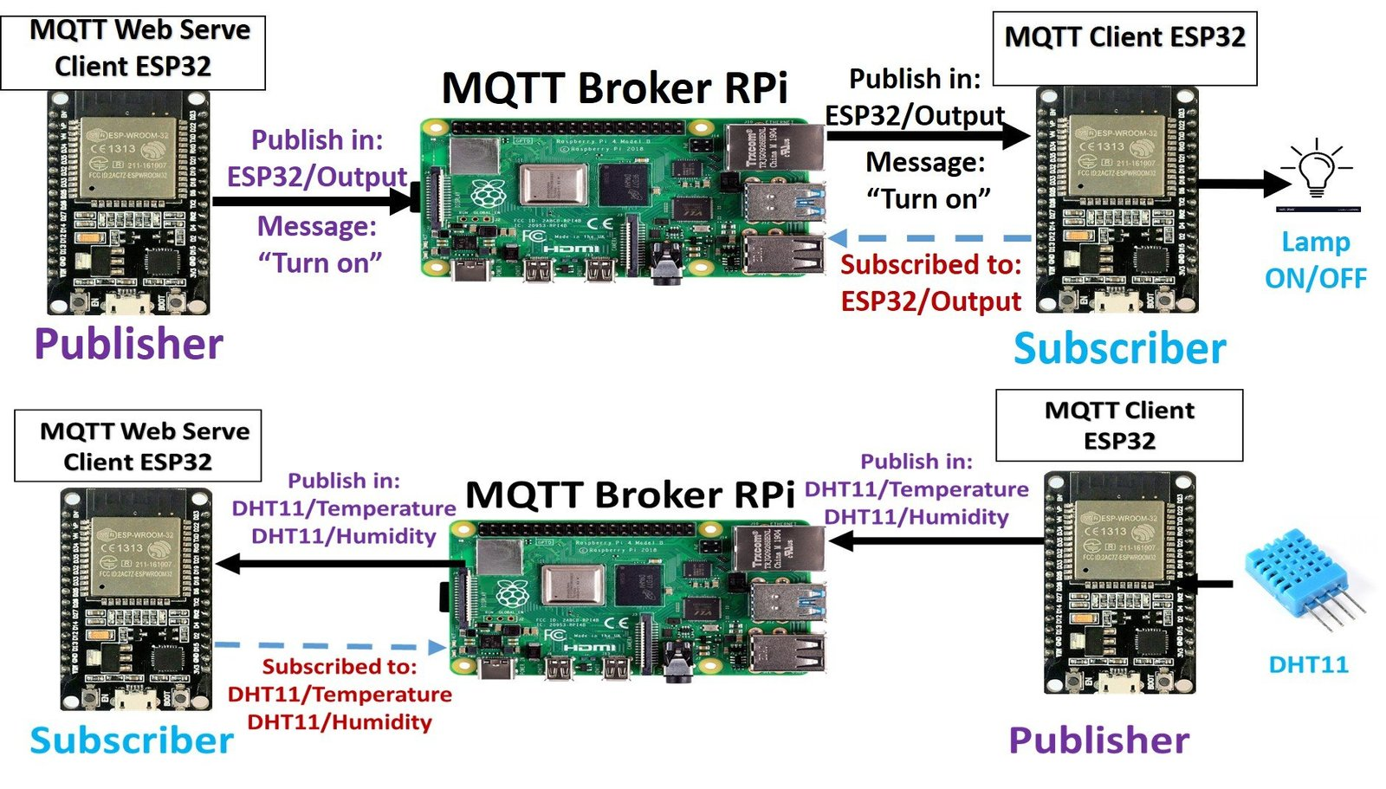

Slide 18
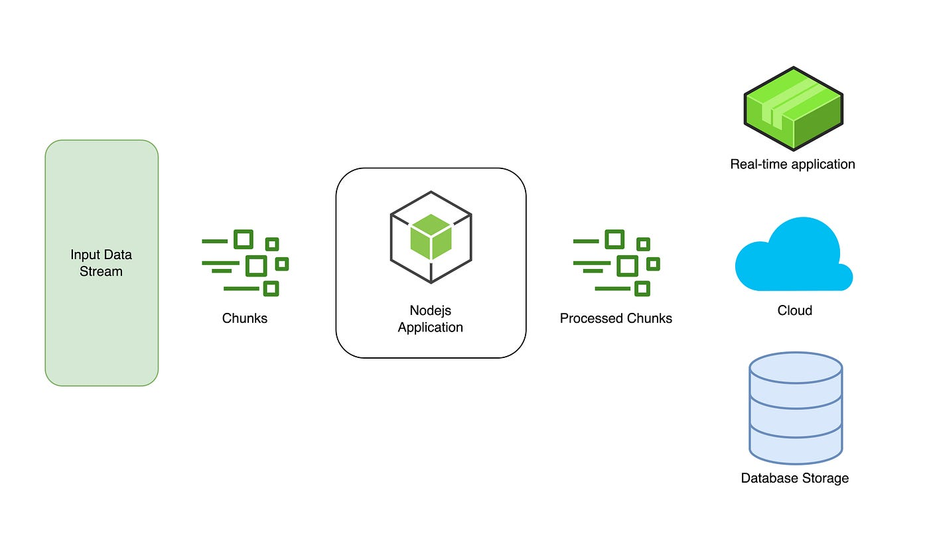
Node Red
Install Node.js

Slide 19
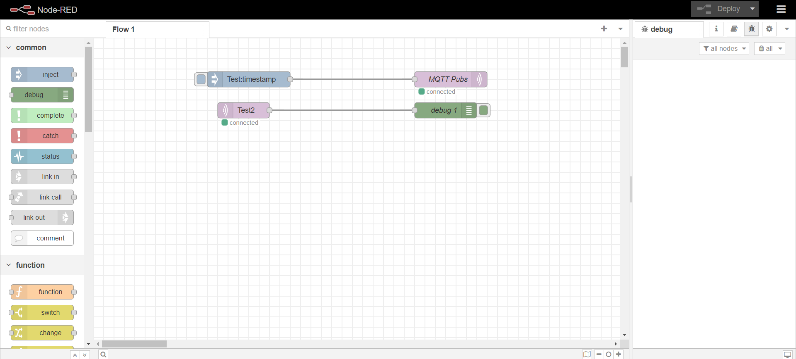
Node Red
Open CMD window
node –v
node-red

Slide 20
